Slide 1
Robustness of Microarchitecture Attacks/Malware Detection Tools against Adversarial Artificial Intelligence Attacks
Team 16
Liam Anderson
Kevin Lin
Shi Yong Goh
Felipe Bautista
Connor McLoud
Eduardo Robles
Client/Adviser: Berk Gulmezoglu

Slide 2
Project Background – Microarchitecture Attacks
Microarchitecture attacks are malware that exploits the hardware infrastructure itself.
Different from average malware that exploits a system's software.
Examples:
Spectre attack: Exploits a processor's speculative execution optimization and performs a side-channel timing attack on the cache to leak data
Row hammer attack: Rapidly accesses memory rows to interact electrically with neighboring rows and alter their data.

Slide 3
Project Background – Power Signatures
Typical anti-malware solutions cannot detect or stop microarchitecture attacks ,so alternate solutions are needed.
One proposed method is to monitor the CPU's power consumption for malicious power signatures.
A power signature is a set of power consumption data from the CPU that uniquely identifies a program's function.

Slide 4
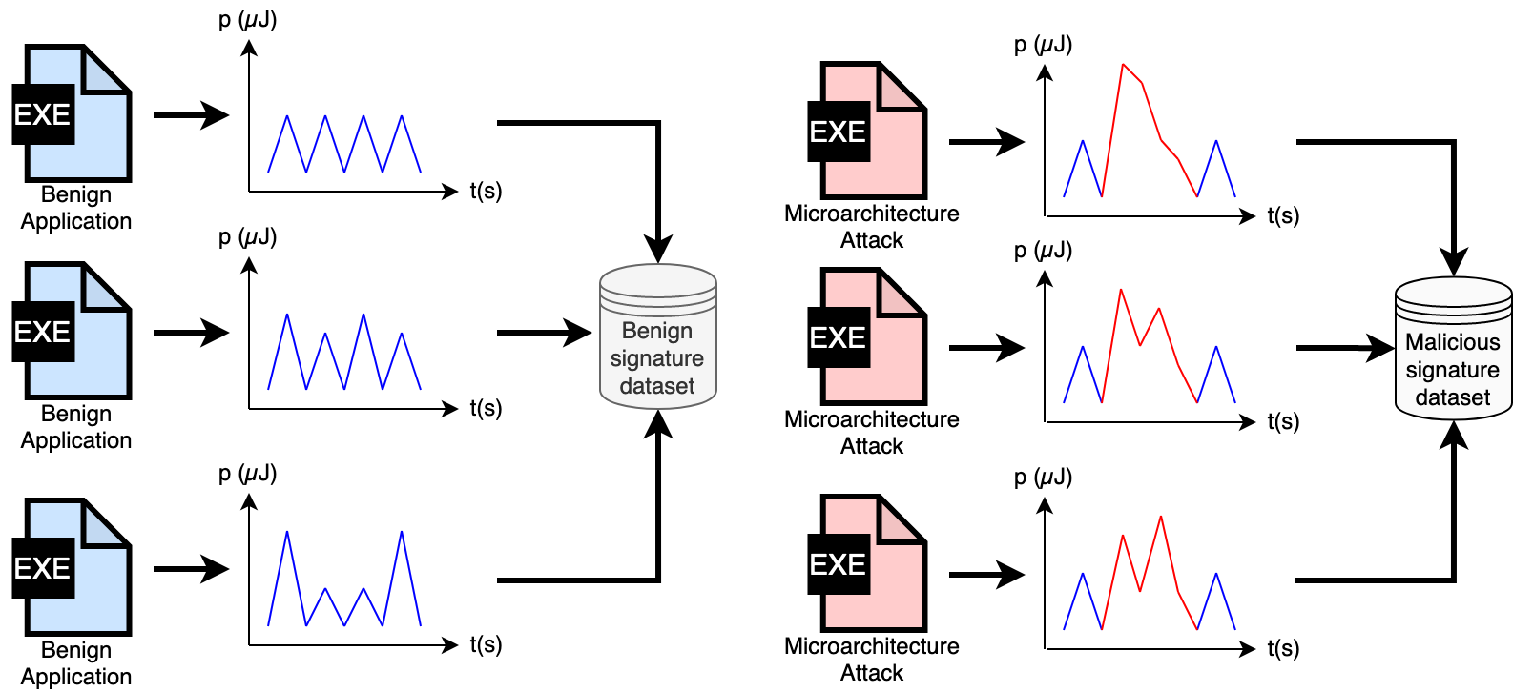
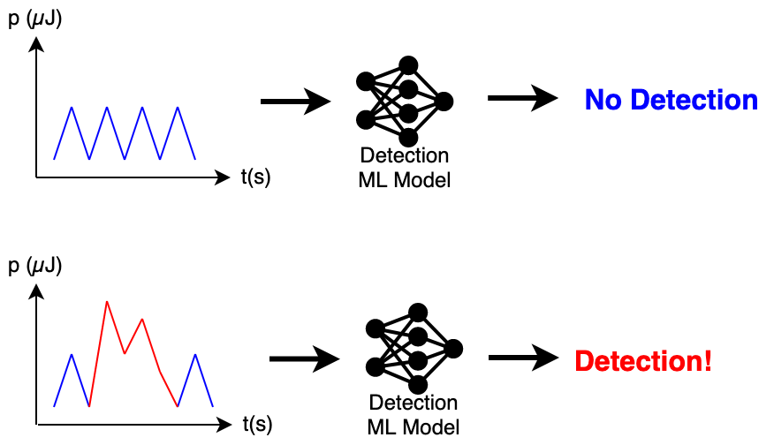
Project Background – Detection ML Model
A convolutional neural network (CNN) machine learning (ML) model is used to analyze and determine if the power signature is malicious.
The model is trained with benign and malicious power signature datasets.

Slide 5
Project Background – Adversarial Attacks
Both the machine learning model and test system used for recording power signatures are given to us
We are not responsible for developing or maintaining these systems but instead tasks with testing their robustness
A detection system's robustness can be tested with adversarial attacks
Adversarial attacks generate artificial noise to deceive machine learning models

Slide 6
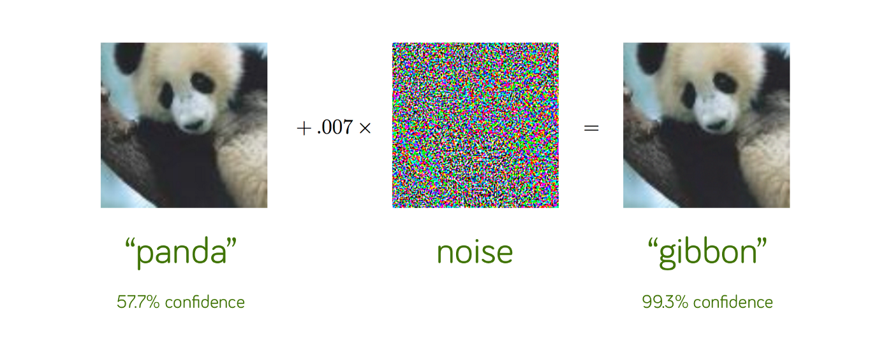
Project Background – Adversarial Attacks
Jain, Anant. “Breaking Neural Networks with Adversarial Attacks.” Medium, 6 Jan. 2020, https://towardsdatascience.com/breaking-neural-networks-with-adversarial-attacks-f4290a9a45aa.

Slide 7
Project Background – Adversarial Attacks
Like the panda example, we want to trick the ML model by inserting noise.
The "noise," in our case, is x86 assembly instructions.
We still want the microarchitecture attack to run efficiently.

Slide 8
Project Vision
Goals
Create a simple and user-friendly graphical user interface (GUI) that will automate the current manual process of assessing the robustness of security systems that attempt to detect microarchitecture attacks.
Research and develop evasive adversary attacks by inserting artificial noise into the attack instructions to mimic benign power signatures and exploit the security system’s underlying machine-learning model.
Use cases
Researchers, who focusing on microarchitecture attacks
Use our tool to test and further research power-anomaly detection systems
Use our research to further develop their own adversary attacks
Implementors, such as Intel, AMD, Nvidia, and PaaS providers
User our research and findings on evasive adversary attacks to further increase the security of their own power-anomaly detection systems
End Users
indirectly benefit by trusting their data with systems tested by our tool

Slide 9
Functional Requirements
Evasive Attack Requirements:
The evasive attack should not surpass 5x slower data leak rate than its non-evasive counterpart
The evasive attack's power consumption should not exceed 2x that of its non-evasive counterpart
The evasive attack should be able to perform the attack successfully with the above requirements, and have the ML model report a confidence rate below 20%.

Slide 10
Functional Requirements
GUI Requirements
Must allow users to do the following tasks:
Define evasive attack type via a dropdown
Upload the dataset they used via file upload
Upload evasive attack source code via file upload
Select a detection model to test the evasive attack via a dropdown
After running an attack, the GUI must display statistics about the attack
The data leak rate in bits per second
The detection certainty for the selected model as a percentage.

Slide 11
Resource Requirements
Our team will be provided and required to use the following system and trained Detection Model:
Intel Comet Lake Microarchitecture – System – accessed via SSH
CPU Model: Intel(R) Core (TM) i7-10610U CPU @ 1.80GHz
OS: Ubuntu 20.04 LTS
Linux Kernel: 5.11.0-46-generic
Server Information – Trained Model – accessed via SSH
Nvidia GeForce RTX 3090 GPU
CPU Model: Intel(R) Xeon(R) Gold 5218 CPU @ 2.30GHz

Slide 12
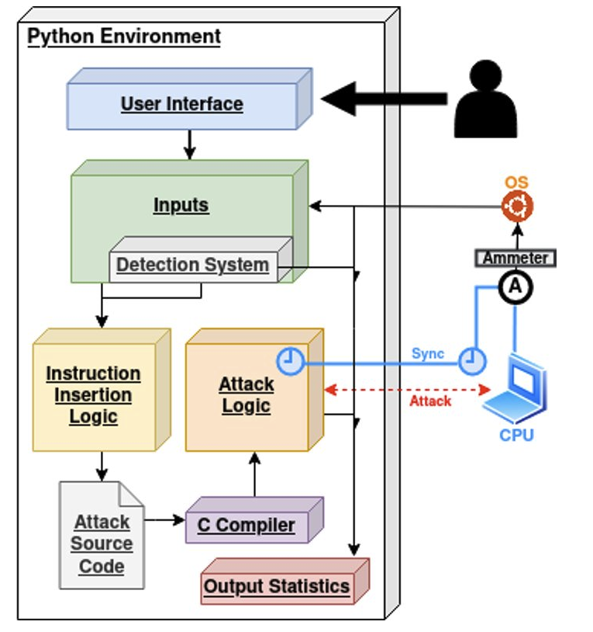
Conceptual Design Diagram
Our software will offer a graphical user interface (GUI) or command line interface (CLI) for the user to interact with the application. Navigating the interface, the user can upload information relative to the attack code and detection model itself. This data is fed back into the instruction insertion algorithm.
The algorithm generates an evasive attack that exploits the detection system's underlying machine learning (ML) model. Running the attack with the program will generate statistics about the attack.

Slide 13
System Design – Component Diagram
User Interface - Clients will be provided both a CLI and GUI to interact with our application.
Inputs - The available options to the client include the type of attack, attack source code, and detection model.
Instruction Insertion Logic - Inputs are fed into an algorithm that is compared to our power consumption readings dataset. This generates & compiles new attack source code designed to subserve the selected model.
Attack Logic – The compiled code is passed onto our attack logic where it is ran to determine whether it is malicious or benign. This is done by measuring the host machines power usage as the attack is running while also detecting for any anomalies that were already quantified by the machine learning model.
Outputs – The data generated above is directed back to our CLI or GUI for the client to view. Whether the code is malicious or not is shown as a "certainty percentage."

Slide 14
System Design – Functional Decomposition

Slide 15
System Design – Technology Considerations
Python
Pros:
Simple to use for AI/ML applications
Versatile & platform independent
Useful libraries & module ecosystem
Cons:
It is an interpreted language causing slow execution times
High Memory Consumption
C Attack Code
Pros:
Very fast execution & compile times
It is a low level language, useful for machine level hardware
Common place in our field
Cons:
No runtime error handling
No exception handling
Manual Memory management
X86 Instructions
Pros:
Most commonly used ISA today
Targets the devices that the attack codes are designed for
Vast number of instructions available
Cons:
Steeper learning curve

Slide 16
System Design – IEEE Standards
Software Development Lifecycle:
IEEE 12207: This standard provides processes that can be employed for defining, controlling, and improving software life cycle processes within an organization or a project.
IEEE 1074: This standard provides a process for creating a software project life cycle process (SPLCP) and it is primarily directed at the process architect for a given software project.
Software Testing:
IEEE 29119: This is a series of five standards for software testing. They define vocabulary, processes, documentation, techniques, and a process assessment model for testing that can be used within any software development lifecycle.

Slide 17
Risks and Mitigation
Medium Risk:
Attack code has a detection rate higher than 20%
This means the attack code was unable to mimic a benign application
Can be mitigated by allocating more time into analyzing the benign application's power consumption
Leakage rate may be difficult to calculate
The user will not be able to tell how efficient the attack was
The team will spend more time researching the attack code
High Risk:
Two people run an attack at the same time
Multiply attacks occurring at the same time will produce inaccurate data
Communicate with the team when attacks are executed
Row hammer attack may crash the system
This can ruin the RAM of the computer and will need to be replaced.
Have a good understanding of the attack and carefully implementing it.
Inability to analyze and understand power samples
This will halt development as the team will have to spend more time doing research.
Ask for guidance from client and use outside resources.

Slide 18
Milestones/Tasks
Tasks
Understand how the attack code works
Develop a UI to run the attack and collect power measurements
Analyze power signatures
Implement basic instructions into the attack code
Finalize the project

Slide 19
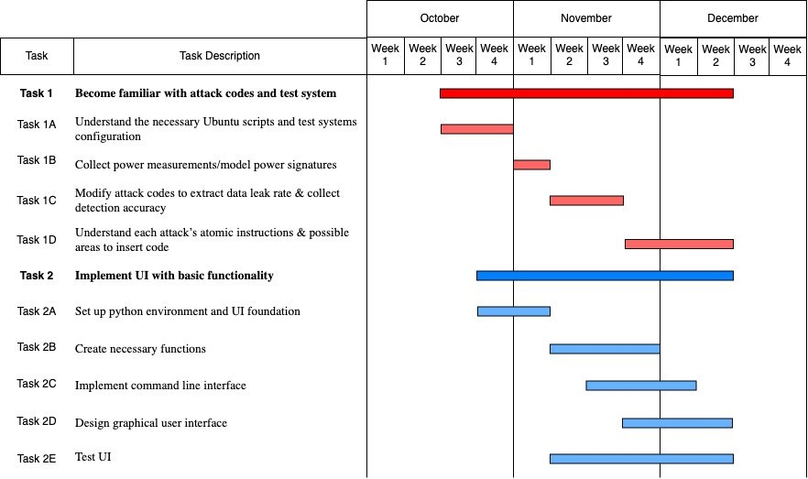
Milestone Schedule - Fall

Slide 20
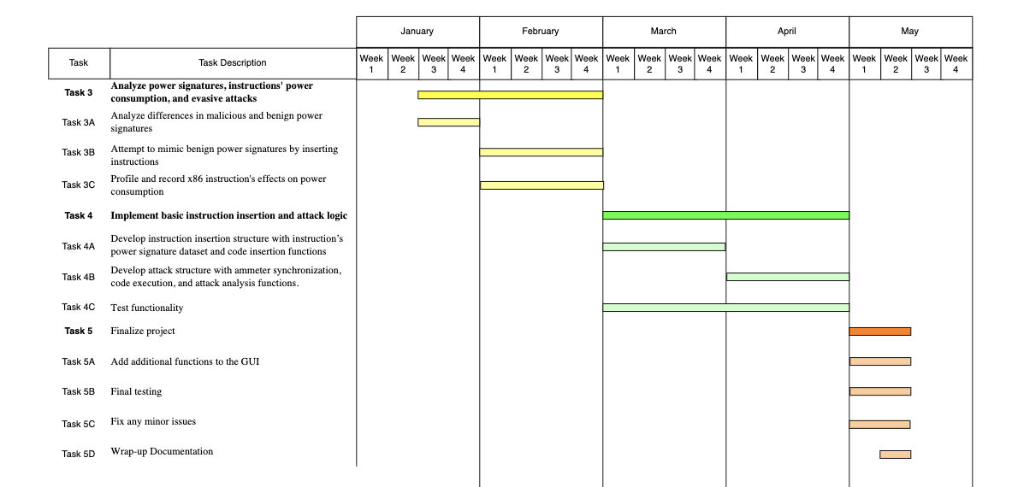
Milestone Schedule - Spring

Slide 21
Test Plan: Unit Testing
Instruction Insertion Unit (IIU)
Test the basic functionality of inserting instructions
Inserting the correct x86 instructions in the right location without breaking the program
Attack Unit (AU)
Use a Python script to call the unit with various attack inputs
Expected to see that
The unit runs an attack a given number of times
It collects the amount of data leaked and how long each attack takes to execute.

Slide 22
Test Plan: Interface Testing
Data Type Errors & Error Logging
Each one of the methods handles data type errors correctly as well as to make sure it is logging any errors it encounters
UI Component Testing
All fields, labels, buttons, and other items on the screen will be tested to make sure they are functioning as desired.
Screen Response/ Navigation Elements Testing
Testing navigation tools such as scroll bars and navigation bars to ensure smooth transitions while navigating the page, and refresh rate of the page.
Output Testing
Testing the output given back to users to meet the UI requirements

Slide 23
Test Plan: Integration Testing & System Testing
Instruction Insertion Unit / Attack Unit Integration
A Python script will provide the IIU with various attack codes
The attack runs the appropriate number of times without any errors
The correct statistics are outputted
The attack speed is not significantly slowed down
UI / Internal Logic Integration
A Python script, but manual effort will be involved (navigating the UI)
We expect to see the following:
Importing source files works as expected
Selecting a detection model successfully loads the internal machine-learning model and data sets
Attacks successfully run with the selected type
GUI Requirements
System Testing (similar to the UI / internal logic integration testing)
Also, check to see if our tool has met the Evasive Attack Requirements.

Slide 24
Test Plan: Acceptance Testing & Summary
User Acceptance Testing (UAT)
Our clients will test the detection tool
Test procedure:
Download the tool on their devices.
Upload different sources files to run the tool.
Use different attack types to run.
Evaluate the correctness of the tool.
Summary

Slide 25
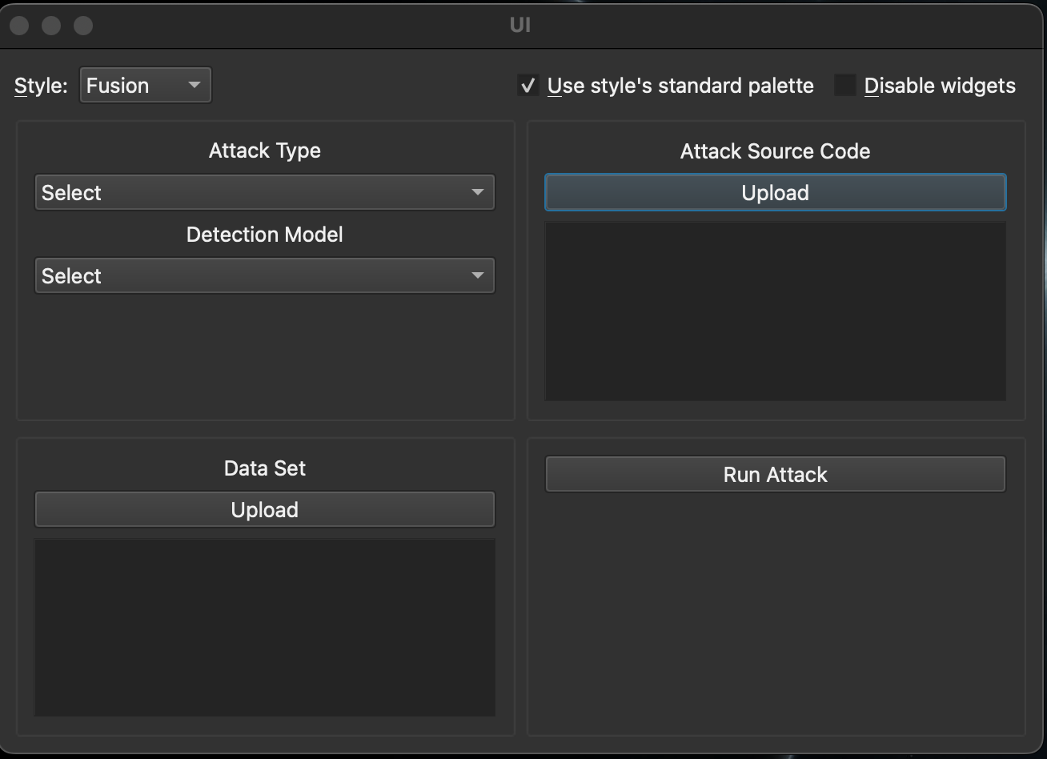
Current Process: Graphical User Interface
Currently still in development.
Developed using Python and PyQT6 library
Not finalized
Needs some visual Improvements, testing for user experience
GUI Prototype

Slide 26
Current Process: Instruction Insertion Analysis
When reading the power data measurements, the power usage is continuously increasing.
To get an accurate measurement, we have to take the difference between every two data points. Plotted against time, this results in a graph like the above.
After smoothing out the data, we get something like below.
This graph shows the power usage over time as we run a Spectre attack. The dips in power indicate when the Spectre attack is running.

Slide 27
Current Process: Instruction Insertion Analysis
These images show how we insert x86 instructions into the source code to hopefully modify the power that the code takes.
The hope is that these instructions take more power and will make it harder for the ML model to detect that it is an attack.

Slide 28
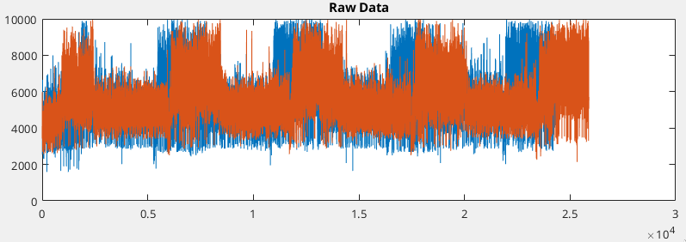
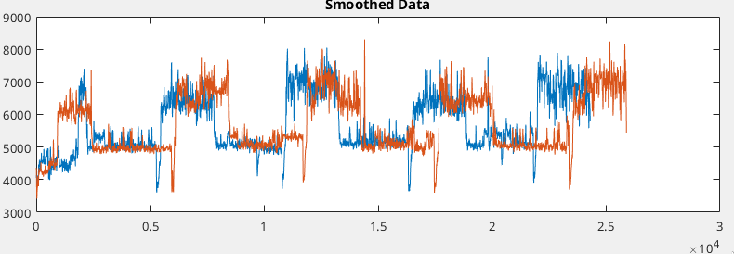
Current Process: Instruction Insertion Analysis
This is an example of the original Spectre attack against a Spectre attack modified with many signed multiply operations in x86. These are inserted in various places in the code.
We are in the process of analyzing these graphs and seeing if we can produce a more noticeable jump or different patterns. In this example, the only real difference is a delay between execution.

Slide 29
Conclusions
What's Next?
Continued development of GUI/CLI
Continued analysis of instruction insertions
Addition of other types of attacks
Development of instruction insertion and attack logic functions
Kevin | Instruction insertion analysis, scripting
Liam | Instruction insertion analysis, scripting, MATLAB
Shi Yong | Instruction insertion analysis
Eduardo | Instruction insertion analysis
Felipe | GUI development
Connor | Assisted in GUI development

